Slide 1
WillTools
A QC instrument for precast shop tickets and panel handling
pyRevit extension + standalone engineering solver
Internal introduction · precast engineering team
Notes:
Welcome -- this is an introduction to WillTools, a tool one of our precast engineers has been building to check shop tickets and panel handling calculations. I want to walk through three things today: what problem it solves, how it's actually built under the hood, and what it looks like when you press the buttons. This is a working tool, not a pitch -- everything you'll see on screen is either a real report from the software or is clearly labeled as an illustration. We'll spend about 20 to 25 minutes on this, with time for questions at the end.

Slide 2
AGENDA
What we'll cover
The problem -- what shop-ticket QC looks like today
What it is -- the two halves and the shape of the tool
Why you can trust it -- the two ideas the whole thing rests on
How it's built -- the runtime split, the knowledge layers, the report contract
The algorithms -- the beam, the capacity equations, the donor matcher
A tour of the buttons -- real screenshots, real numbers
What it will NOT do -- on purpose
Trying it, and how to tell us what's broken
Where it's going
2
Notes:
Quick roadmap for the talk. We'll start with the problem and the premise, then go under the hood into how it's actually built -- runtimes, knowledge layers, algorithms -- since some of you may end up reading or contributing to this code, not just using it. Then a tour of the four finished buttons with real output. We'll close with what it deliberately refuses to do, how to install it and file a good bug report, and a short honest roadmap.

Slide 3
THE PROBLEM
Shop-ticket QC, today
Every ticket gets checked against the design by hand -- f′c, f′ci, jacking force, strand count / grade / diameter / position, W.W.F., unit weight, embeds, bar marks, size envelope, interference
It's not one sheet. A ticket is the union of every sheet issued for that mark, and a design can carry dozens of marks
As of today, that's 37 check functions feeding 46 checklist rows on the flagship Ticket QC button -- verified by running the code, not by reading a spec
It's the same arithmetic, on every ticket, under deadline -- exactly the condition where a tired reviewer skips a line
Verified 2026-09-02: len(ticketchecks.CHECKS)=37, len(ticketpage.CHECKLIST_ITEMS)=46.
3
Notes:
This is the starting point. Precast shop tickets carry a lot of numbers that all have to agree with the design: concrete strength at release and at 28 days, prestressing force, strand pattern, welded wire fabric, weight, embed locations in two directions, bar marks, and whether anything on the sheet overlaps or is missing. Checking one ticket against its design summary is not hard. Checking every ticket, on every sheet, for every mark, on a tight schedule, by hand, every single time -- that's where mistakes get made, not because anyone is careless but because it's repetitive arithmetic done under time pressure. I actually ran the numbers on this repo this morning: 37 registered check functions feed 46 rows on the checklist page. That's the scope we're talking about, for one ticket.

Slide 4
THE PROBLEM
What a missed defect costs
A lifter rated below what the piece actually pulls on it
An opening or recess that lands too close to -- or cuts into -- the strand pattern
A capacity number pulled from the wrong knowledge layer, or from nothing at all
These aren't hypothetical categories -- they're exactly the checks the tool runs, and in a minute you'll see a real one fire
4
Notes:
None of these are exotic failure modes -- they're the ordinary ones. A wrong lifter rating, an opening that got moved late in design and now sits over the strand pattern, a capacity value that was correct for one plant and got silently reused for another. Every one of those is cheap to catch on a screen and expensive to catch on the yard. Later in this talk I'll show you a real -- sanitized, but real -- run of the panel lift check that catches exactly this kind of thing: a set of anchors carrying 113% of their rated tension load. That's not a made-up number for the slide, that's actual output from actual code.

Slide 5
THE PROBLEM
The premise
The Revit model already holds most of what a checker is looking for -- strand positions, embed locations, member geometry, jacking force, concrete strength
What's missing is arithmetic, discipline, and somewhere to write down what THIS plant actually does
WillTools exists to supply exactly those three things -- and nothing more
Scope is deliberately narrow: one engineer's QC instrument, for cladding and wall panels -- not a plant production system, not a beam/slab/column tool
PROJECT.md §1.1
5
Notes:
The premise of the whole project is simple: the model isn't the problem. Everything the checker needs is usually already in the model somewhere -- it's just scattered across parameters, geometry, and someone's memory of how this particular plant does things. What's missing is the arithmetic to compare it against the design, the discipline to do that every time instead of only when there's time, and a place to actually write down plant-specific standards instead of carrying them in someone's head. WillTools' scope is deliberately narrow -- it's built for one engineer's own responsibility, cladding and wall panels, not a plant-wide production system and not beams, slabs, or columns. That narrowness is on purpose; the knowledge behind every check was only ever validated against panels.

Slide 6
WHAT IT IS
Two halves, one contract
WillTools.extension -- a pyRevit extension. Runs inside Revit, on the UI thread. It measures the model. That's all.
panellift / tools -- plain CPython, outside Revit entirely. It solves the mechanics, runs the checks, writes the report.
The two never share memory or import each other. They talk through one JSON file: a deck goes in, a report comes out.
One tab in Revit, four panels: Tools, Setup, Design, Lab -- four finished buttons on Tools do the engineering work
6
Notes:
At the highest level WillTools is two pieces of software that barely know about each other. Inside Revit, on Revit's own UI thread, is a pyRevit extension whose only job is to measure things off the model -- geometry, strand positions, insert locations -- and write them to a file. Everything that actually computes anything, checks anything, or writes a report happens outside Revit entirely, in plain Python. They're connected by exactly one thing: a JSON file. We'll spend a whole slide on why that split exists a little later, because it's not an accident -- it's the single most important architectural decision in the whole codebase. In the ribbon itself, everything lives under one WillTools tab with four panels, and the four buttons that matter -- Reinforce, Panel Lift, Ticket QC, Snapshot -- are the big ones on the Tools panel.

Slide 7
WHAT IT IS
The shape of the tool
Knowledge layers -- the plant's own standards, written down as DATA, with a citation -- never hardcoded into the checking logic
Checks -- pure arithmetic that reads what was measured plus what the knowledge layers say is true here
A report a human can argue with -- every finding carries a reason, not just a verdict
That third piece is not decoration. A report nobody can push back on is a report nobody actually reads
7
Notes:
So the shape of the tool, end to end, is: knowledge as data, checks as arithmetic over that data, and a report designed to be argued with. The knowledge-as-data piece matters because every plant does things a little differently -- bar stock lengths, which end is up, rigging conventions -- and none of that belongs baked into Python code where only a programmer can change it. It belongs in a YAML file an engineer can edit and a citation can point at. The report being arguable is just as important -- if a finding just says FAIL with no explanation, engineers learn to distrust or ignore it. Every finding in this tool carries the reason it fired, in a sentence, so you can check the tool's logic against your own judgment. That's the setup for the two big ideas coming up.

Slide 8
WHY YOU CAN TRUST IT
Idea 1 -- “Could not judge” is a first-class answer
Every check returns one of three things -- a verdict, NOT JUDGED with a written reason, or a real finding. Never a guess standing in for either.
NOT RUN renders RED, the same as FAIL -- never grey, never calmer-looking than a real failure
The rule the whole tool is organized around: silence is never a pass
The incident that bought this rule -- one unauthorized exclusion once hid forty tickets, and every check that ran on the rest came back clean
PROJECT.md §3.1 -- “NOT RUN is never a pass. Silence that looks like success is the cardinal sin.”
8
Notes:
This is the first of the two ideas the owner considers the heart of the tool. Most QC tooling collapses two very different situations into one blank: 'I checked and found nothing wrong' and 'I couldn't check this at all.' Those are opposite answers and treating them the same is dangerous, because a report full of green checkmarks reads as confidence whether or not anything actually got checked. So every single check in this tool is required to distinguish those two cases explicitly -- there's even a test that fails, by name, the day a new check ships without a documented reason for why it might come back empty. And when a check genuinely could not run, the row renders red, the same color as a real failure -- on purpose, so an unread row can never look calmer than a broken one. This isn't theoretical: a job once had forty tickets silently excluded from a QC sweep by an undeclared scope decision, and because every check that DID run came back clean, the report looked perfect. That incident is why NOT RUN is red today.

Slide 9
WHY YOU CAN TRUST IT
Idea 2 -- Every number carries its provenance
Five layers, checked in order: code defaults, the published catalogue, the plant, the job, the engineer's own project config
Job beats plant beats what everybody in the trade knows -- not a tie-break, a statement about where the truth actually lives
Every number on a report can be traced back to which layer set it, and which page or ruling it came from
A wrong number you can trace is a five-minute fix. A wrong number nobody can find the source of is a lost afternoon.
PROJECT.md §2.3, §3.2; CLAUDE.md §3
9
Notes:
The second big idea is that no number in this tool floats free -- every value that goes into a check can be traced back to exactly which layer decided it, and why that layer wins. There are five layers, each overriding the one before: what the code assumes by default, a published manufacturer catalogue that ships with the tool, this plant's own standards, this specific job's overrides, and finally whatever the engineer set by hand in a project config file. The rule for where a fact belongs isn't a style preference, it's an argument -- the trade knows a bar mark is a recipe, the plant knows its own hardware, the job knows what was actually drawn. There's an honestly documented incident in this codebase where a hardware rating override got silently dropped during a refactor, and because the fallback catalogue value was lower than the real one, several real panels threw false failures until someone traced the number back through the layers and found the missing override. That's provenance actually doing its job -- the bug was found precisely BECAUSE every number could be traced.

Slide 10
HOW IT'S BUILT
Two runtimes, one line between them
Inside Revit -- IronPython 2.7.12, on Revit's UI thread. Measures the piece, writes a job file. Nothing else.
Outside Revit -- CPython 3.9+. Solves the mechanics, runs the checks, writes the report. Never touches Revit.
The two talk ONLY through that one JSON job file -- hand-writable, re-runnable, needs no Revit and no license to inspect
panellift is deliberately unimportable from inside Revit -- a calculation reaching a plant has to be verifiable by a test suite with no license, no model, and no Windows
PROJECT.md §2.1, §2.2; docs/lift-check.md
10
Notes:
Here's the architectural decision everything else depends on. Revit runs an old scripting engine -- IronPython 2.7 -- and Revit's own API only exists on Revit's UI thread. That side of the tool is kept deliberately dumb: it measures geometry off the model and writes it to a JSON file. All the actual engineering -- the beam mechanics, the capacity checks, the report generation -- lives in plain modern Python, completely outside Revit, and is structured so it CANNOT import anything Revit-specific even by accident. The two sides talk through exactly one channel: that job file. That means you can take the file panellift wrote for a real panel, hand it to someone with no Revit license at all, and they can re-run the exact same calculation from a terminal. That's not a side benefit, it's the whole reason the engineering side is written the way it is -- a number that reaches a plant has to be checkable by a test suite that needs nothing but Python.

Slide 11
HOW IT'S BUILT
The knowledge-layer merge
Code defaults
what the tool assumes, shipped in this repo
Deep-merge: maps merge key by key, lists REPLACE outright.
Deepest layer wins per key.
Re-read fresh every run -- edit the plant file, the next press sees it, no rebuild.
Every value keeps its source: which layer, which page, who said so.
Published catalogue
manufacturer ratings, identifies nobody
Plant knowledge
naming conventions, casting-bed rails, hardware ratings
Job knowledge
what was actually drawn on this job
Project config
the engineer's own setting, made by hand, wins last
11
Notes:
This is the mechanism behind idea two. Five layers, stacked in this order, each one overriding the layer above it for any key it actually sets. Two things worth knowing if you ever touch a knowledge file yourself: maps merge, so adding one field to the job layer doesn't wipe out the rest of the plant layer -- but lists REPLACE outright, so adding one entry to a list in the job file silently deletes everything the plant file had in that same list. That's a documented sharp edge, not a secret. And the whole thing is read fresh on every single run -- there's no compiled or cached knowledge base, so if you fix a typo in the plant file, the very next button press already sees the fix, on the live model, without restarting anything.

Slide 12
HOW IT'S BUILT
The report as the contract
Findings carry a reason -- not just a code. The text is written to be read by an engineer, not grepped by a script.
The checklist table IS the page -- unfolded, one row per ticket that has anything to say, loudest problems first
Folding is a contract: the answer is never folded away. Everything else starts closed. A section carrying a problem opens itself.
The reader's half of that contract -- if nothing below the tables is open, nothing needs you
12
Notes:
The report format itself is designed around one habit: an engineer should be able to open it, glance at what's already open, and know immediately whether they need to read further. Every section that carries no problem starts collapsed. Any section that DOES have something wrong opens itself automatically. So the rule for the reader becomes simple -- if nothing below the summary table is open, nothing needs your attention. That's a deliberate design decision, not a default from some report-generation library -- there's actually a technical constraint behind it too, because the panel this renders in inside Revit is an old Internet Explorer 7 rendering engine that doesn't support the native HTML disclosure widget, so the fold behavior had to be hand-built in a way that fails LOUDLY rather than silently if it breaks.

Slide 13
THE ALGORITHMS
Panel Lift Check -- the panel as a beam
Each stage -- stripping, transportation, erection -- is idealized as a beam, supported at that stage's rigging or insert lines
A station profile at roughly L/20, PLUS every real discontinuity: both ends, every opening edge, every pick or dunnage line, the peak and trough of shear and moment
Element loads are integrated against Hermite shape functions -- so the computed reactions equal the integral of the applied load EXACTLY, not approximately
Checked against a published source: it reproduces every number in the ASPIRE Winter 2019 worked example, and derives PCI's 0.0214 moment coefficient from the beam solution rather than quoting it
panellift/src/panellift/statics.py, pci.py; README.md
13
Notes:
The panel handling check -- PCI Design Handbook Chapter 8 -- treats the panel at each stage as a simple beam. The mechanics are exact beam theory, but the station sampling is deliberately smarter than evenly-spaced points: it takes roughly one station every twentieth of the span, but it never lets that even spacing miss the points that actually matter -- both ends of the piece, every opening edge, every pick and dunnage line, and the exact peak and trough of the shear and moment diagrams. The element loads are integrated using Hermite shape functions rather than just summed point loads, which means the reactions the solver computes equal the exact integral of the applied load, not a numerical approximation of it. And critically, this isn't just trusted on faith -- the whole engine is checked against a published, peer-reviewed worked example from ASPIRE magazine, and it actually derives PCI's well-known 0.0214 moment coefficient from the beam solution itself rather than hard-coding the published number.

Slide 14
THE ALGORITHMS
Panel Lift Check -- capacity, honestly approximate
M_cr -- cracking moment, ACI 318-19 §24.5.2.4: S(f_r + P/A) ∓ Pe, with f_r = 7.5λ√f′c -- the CODE modulus of rupture, flagged wherever it could be confused with a handling stress allowable that happens to share the same 7.5
φM_n -- strand-only flexure, ACI's approximate f_ps (Eq. 20.3.2.3.1) with the Whitney stress block. No mild steel in the equation, because none exists in the model to give it.
Capacity ramps 0 → f_se over the transfer length, → f_ps at the development length -- the SAME length feeding both the stress check and the capacity check, never a second one
The sling force is decomposed at every insert: vertical share = tension, horizontal share = V·cotθ = shear -- checked independently, deliberately with NO interaction equation
panellift/src/panellift/capacity.py, prestress.py, checks.py
14
Notes:
This is the flexural and shear capacity side. Three published ACI equations, applied honestly rather than dressed up to look more precise than the inputs support. The cracking moment uses the actual code modulus of rupture -- and the code carries a documented warning on that constant, because 7.5 shows up in two completely different places in handling literature and confusing them is a real, measured failure mode. The flexural capacity uses the APPROXIMATE strand stress equation rather than a full strain-compatibility solution, on purpose -- doing the exact solution would require assuming a stress-strain curve for the strand that nothing in any knowledge layer actually supplies, and a precise-looking number built on a guessed input is exactly the failure mode this whole project exists to avoid. And for the sling force itself, at an inclined pick angle, the vertical and horizontal components are checked SEPARATELY against tension and shear capacity respectively -- explicitly with no interaction equation combining them, because the owner considered adding one and ruled it out by name. We'll see this exact math fire a real finding in a few slides.

Slide 15
THE ALGORITHMS
Reinforcing Suggestion -- set cover, not similarity
Hard filters first -- same design family, same thickness within 0.01 in. Thickness is the strongest geometric rule: it sets the bar layout.
Then: which SMALL COMBINATION of already-reinforced donor panels, together, accounts for every feature of this one -- a set-cover search, not a nearest-neighbor ranking
Every feature comparison happens in inches, through one small injected function judging whether one donor feature covers one target feature
Capped at 4 donors. A shortfall is NAMED, never quietly relaxed to a 5th donor or a looser match.
Openings are judged through-vs-blind by casting a line through the panel thickness and intersecting it with the concrete solid
WillTools.extension/lib/vibe/reinforcematch.py, reinforcebind.py, reinforcecore.py
15
Notes:
This is the donor-matching logic behind Reinforcing Suggestion, and it's a genuinely different problem than it might sound like. The owner's own framing was: 'I want the fewest master panels that, pieced together, reconstruct every detail of this one' -- that's set cover, a classic combinatorial problem, not a similarity ranking. An earlier attempt built a similarity ranker and it answered the wrong question. Before the set-cover search even runs, two hard filters apply: the donor has to be the same design family, and the same thickness within a hundredth of an inch, because thickness is what determines the whole bar layout. Every geometric comparison after that is measured in inches to two decimal places -- by explicit ruling, so a notch that's off by 0.4 inches and a blockout that's off by 0.4 inches are treated as equally 'off'. The search caps out at four donors and if four donors can't cover everything, it says so rather than quietly accepting a fifth or loosening the match. And for figuring out whether an opening actually punches through the panel or is just a shallow recess, it literally casts a line through the thickness at the opening's center and measures how much concrete that line actually crosses.

Slide 16
THE ALGORITHMS
Dependencies -- and why so few
Inside Revit -- Revit 2021 or newer (built against 2025.4), pyRevit 4.8+, IronPython 2.7.12. Nothing extra to install.
Host side (tools/, tests) -- Python 3.9+, PyYAML, pytest, pymupdf. One requirements.txt.
panellift itself -- ZERO dependencies. Standard library only. No network call, no cloud, no license needed to run the solver.
That's not an accident -- a calculation reaching a plant has to be verifiable by anyone, on any machine, in seconds
Run today (2026-09-02): panellift 462 passed / 1 known failure (an unimplemented sandwich-panel idealization); the Revit-side suite, 2,908 passed
Verified 2026-09-02: `cd panellift && python -m pytest -q`; `python -m pytest WillTools.extension/tests -q`.
16
Notes:
For anyone thinking about contributing: the dependency footprint is small and that's deliberate. The Revit extension needs nothing beyond Revit and pyRevit themselves. The host-side tools and test suites need three ordinary packages. And the actual engineering engine, panellift, has ZERO third-party dependencies at all -- standard library only, no network access, nothing that phones home, and critically no Revit license required to even look at it. I ran both test suites myself this morning before this talk: panellift is 462 passing tests with one known, honestly-labeled failure around an insulated sandwich-panel case that isn't implemented yet, and the Revit-side extension suite -- which also runs with no Revit license, no model, and no Windows-specific dependency -- is 2,908 passing tests. That's the kind of thing that only stays true because the project insists on it structurally, not because someone remembered to keep it that way.

Slide 17
A TOUR OF THE BUTTONS
Ticket QC
The flagship. Checks every issued sheet of a design against the extracted spec plus all five knowledge layers
Runs only inside a live Revit session -- there is no host-side way to render its real page for this slide, so what follows is a plain, honest illustration of the SHAPE of its output, not a screenshot
row check state note
2.3 unit weight OK
3.1 f′c OK
4.3 jacking force FOR ENGINEER IT tolerance 100 lb; job override deleted, not corrected
5.4 W.W.F. designation MUTED no mesh on this job (dated reason on file)
5.7 bar longer than its stock NOT RUN per-size stock table unreachable -- named, not guessed
7.1 interference WARN 1 clash found -- engineer judgement by ruling
ILLUSTRATIVE -- a mock of the checklist row shape, not a live screenshot. Row numbers, states and notes are real vocabulary from the tool.
17
Notes:
Ticket QC is the tool's flagship button and I want to be very honest about this slide -- it only runs inside a live, licensed Revit session against a real model, and I don't have that available to screenshot for this deck the way I could for the two host-side tools. So what's on screen is a plain-text mock, clearly labeled as illustrative, showing the actual vocabulary the checklist uses -- OK, FOR ENGINEER, MUTED, NOT RUN, WARN -- these are the real states the tool prints, I just typed example rows rather than pasting a real client's ticket data. Notice row 5.7 is NOT RUN with a reason rather than silently passing -- that's idea one from earlier, in the wild. And note MUTED is not the same as passing either -- a muted row still runs, it's just visually de-emphasized, and the report keeps a separate tally so nobody can mistake 'thirty-one OK' for thirty-one real judgments if four of them were muted.

Slide 18
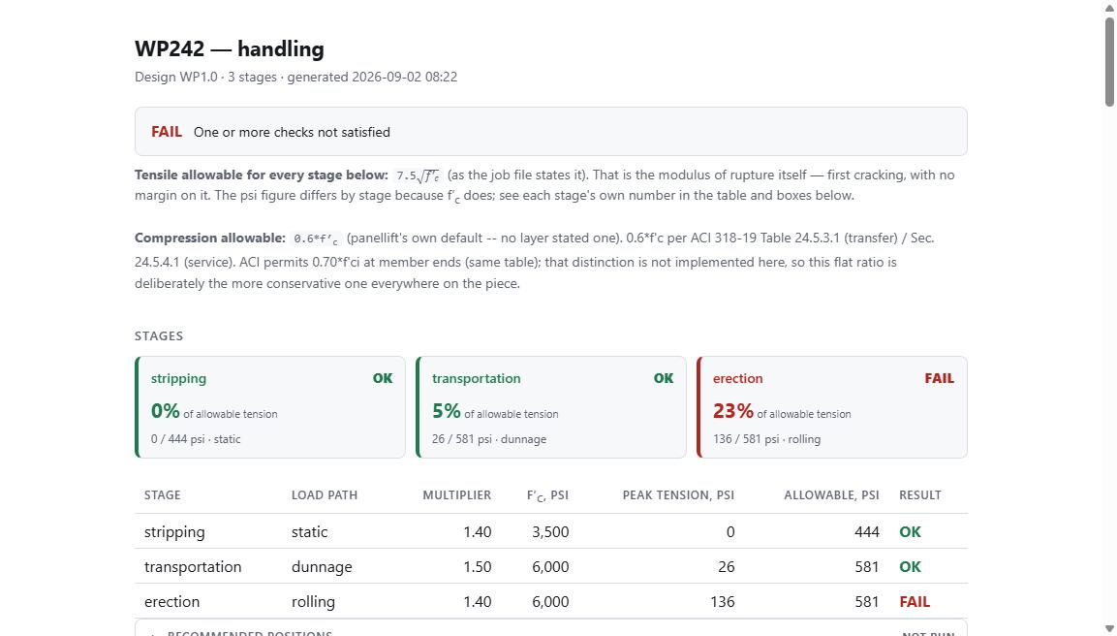
A TOUR OF THE BUTTONS
Panel Lift Check -- the verdict
PCI Chapter 8 handling check: stripping, transportation, erection -- one report per piece
This is a REAL run of the solver against a sanitized deck (mark and dimensions genuine, project identity scrubbed)
Three stages, each against its own tensile allowable -- erection fails here at 23% of allowable tension, which sits under a separate FAIL below
Real output — python -m panellift <sanitized deck> -o report.html
Sanitized from a real sweep deck. source.model set to “sample_job.rvt”; hardware family names replaced with a generic vendor token.
18
Notes:
This is real. Not a mockup -- this is the actual HTML report panellift produced, screenshotted from a browser, off a real job deck that I copied to a scratch folder and edited so the project and producer identity are scrubbed out; the panel mark and every engineering number are untouched. Three handling stages, each checked against its own tensile allowable because concrete strength differs by stage. The stress ratio itself is well within allowable here at 23%, but as we'll see in two slides, that's not the only check this piece fails -- a demand-over-capacity ratio and a tensile-stress ratio are two separate questions, and this report answers both.

Slide 19
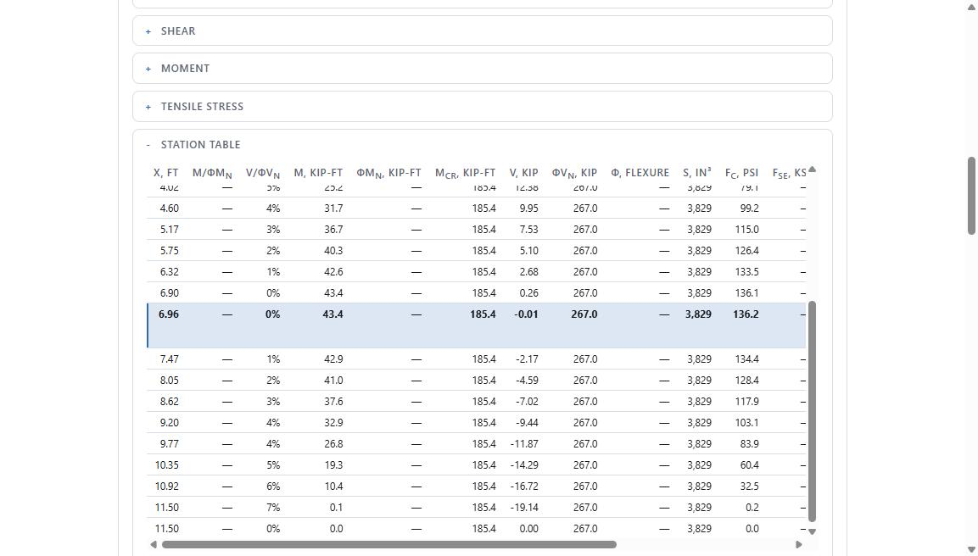
A TOUR OF THE BUTTONS
Panel Lift Check -- the station table
M/φM_n and V/φV_n at every station -- the real engineering notation, not a simplified summary
Thinned by stride, but never at the cost of what matters: both ends, every opening edge, every pick line, and the GOVERNING station -- tinted, bold, and named
25 rows shown out of 2,002 computed. Nothing that matters got thinned away.
Real output — the governing station (x = 6.96 ft) is tinted and bold in the source HTML
Same sanitized run, erection stage, Station Table section.
19
Notes:
The full station table is one of the things I'd point to if someone asked whether this tool is actually engineering-grade or just a pass/fail light. Every column uses real notation -- moment over phi times nominal moment capacity, shear over phi times nominal shear capacity, the cracking moment, the effective prestress. The solver computes over two thousand stations along the piece but only prints a thinned sample -- except it guarantees the thinning never drops the stations that actually matter: both ends, every opening edge, every pick and dunnage line, the peak and trough of shear and moment, and specifically the GOVERNING station -- the one with the worst ratio -- which is visually tinted and bold in the real HTML, and is also the exact station the plotted stress diagram's red dot sits on. That row you can see highlighted is not decoration, it's the station the verdict on the previous slide was actually taken from.

Slide 20
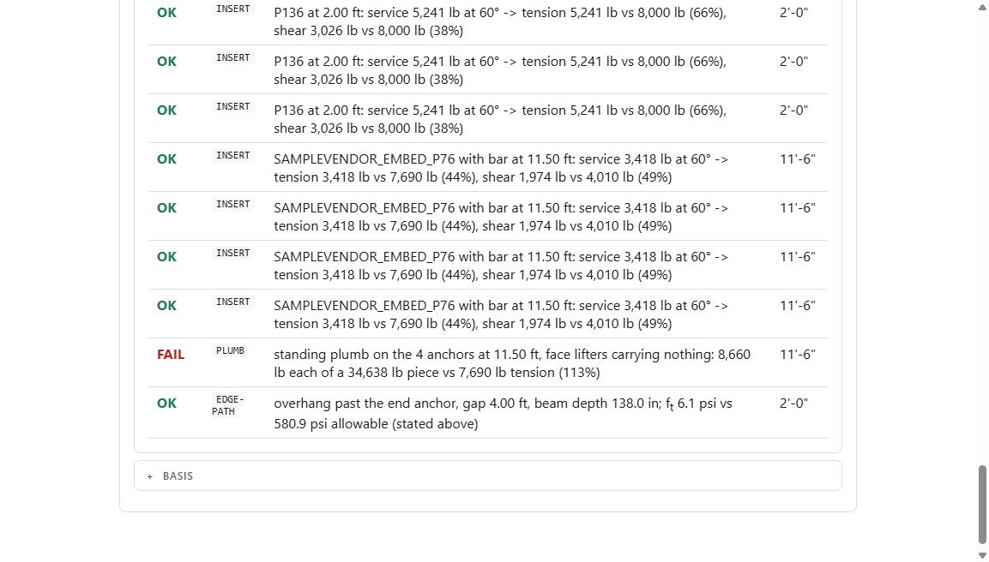
A TOUR OF THE BUTTONS
Panel Lift Check -- a FAIL, decomposed
Every insert check decomposes the sling force: vertical share = tension, horizontal share (V·cotθ) = shear -- checked against each capacity independently
This finding is real and unmodified: 4 anchors standing plumb, 8,660 lb each of a 34,638 lb piece, against a 7,690 lb tension rating -- 113%
Over 1.0 renders FAIL. The report says so and stops there -- it does not discount it, round it down, or soften the language
Real output — the PLUMB finding, unmodified engineering numbers
Same sanitized run, erection stage → Checks section. Family names replaced with a generic vendor token before capture.
20
Notes:
This is the finding I mentioned two slides ago, and every number on it is real, unmodified output -- this is what the tool actually computed against a real deck, only the vendor family name was swapped for a generic placeholder before I took the screenshot. Four anchors, standing the piece plumb during erection, each one carrying 8,660 pounds of an over-seventeen-ton piece, against a 7,690 pound rated tension capacity -- 113 percent. That's a genuine overstress under this run's knowledge configuration, caught by arithmetic, not by a person eyeballing a shop drawing. Notice the row right above it: the exact same math applied to a different insert type comes back OK at 44% and 49% of its tension and shear capacities -- that's the sling-force decomposition from the algorithm slide, working exactly as designed, on two different hardware types on the same piece.

Slide 21
A TOUR OF THE BUTTONS
Reinforcing Suggestion
Finds the smallest set of already-reinforced panels that, pieced together, cover every feature of this one -- see the algorithm slide
Also runs only inside Revit. What follows is an illustrative mock of the ranked-donor table's SHAPE, not a real job's output
donor | coverage | exactness | features covered
WP2.0-R14 | 100% | exact (0.00″ off) | 2 openings, 1 blockout, corner recess
WP2.0-R09 | 78% | close (0.35″ off) | 2 openings, edge notch
WP2.0-R31 | 46% | close (0.40″ off) | 1 blockout, corner recess
— shortfall — | — | — | 1 small notch: no donor covers it -- named, not hidden
ILLUSTRATIVE -- a mock of the ranked-donor table's shape, not a real job's donors. Real donor marks, ranking rule, and cap (≤4) are as described in the algorithm slide.
21
Notes:
Same honesty note as Ticket QC -- Reinforcing Suggestion also only runs against a live model inside Revit, and the real output ties directly to one specific job's actual panel marks, so I built a clearly-labeled mock table instead of trying to redact a real one. What's real here is the shape: donors are ranked by how much of the target panel's features they cover and how exact that coverage is, the search is capped at four donors, and if the donors it found don't cover everything, that shortfall is printed explicitly rather than papered over. This button also, by hard rule, opens no transaction and writes nothing to the model -- it's a suggestion, never an automatic copy, because a wall panel's reinforcing is per-design engineering and copying a donor's cage in automatically would be the single most dangerous thing this tool could do.

Slide 22
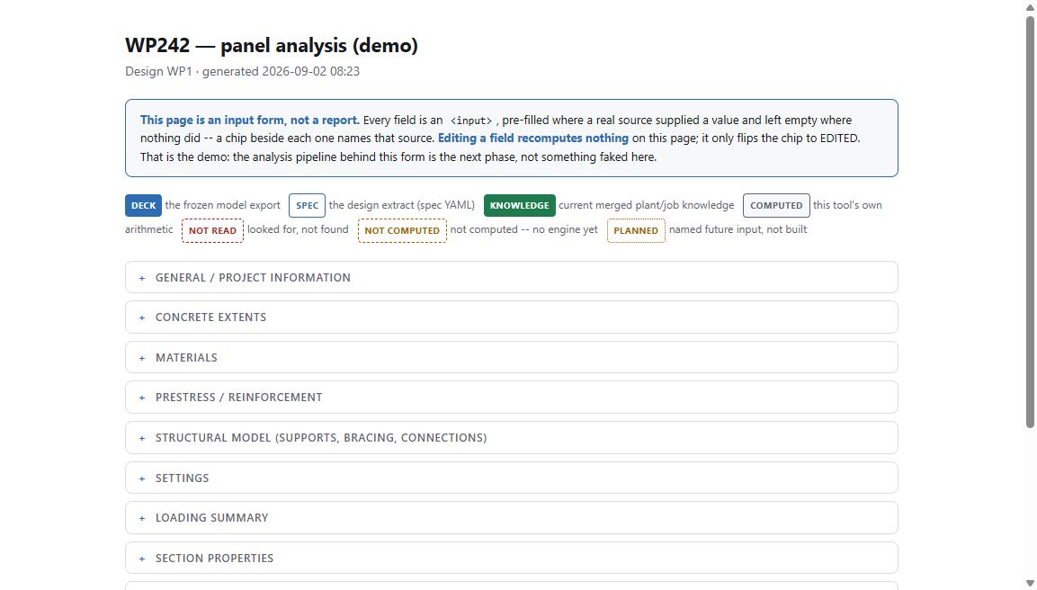
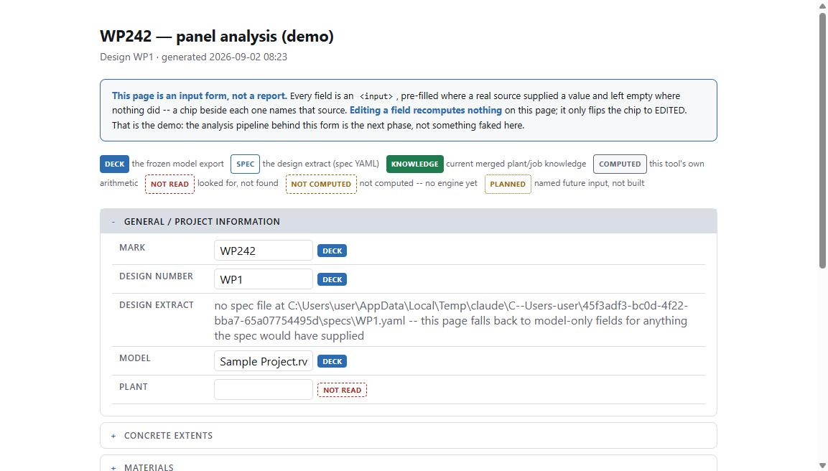
A TOUR OF THE BUTTONS
Panel Analysis (demo) -- the form, and where every number came from
The newest addition. Copies Eriksson Wall's own input organization -- but pre-fills it from what this shop's tools already know
Every field is an editable input, never a read-only cell -- a colored chip beside it names the source: DECK, SPEC, KNOWLEDGE, COMPUTED, or NOT READ
Editing a field recomputes NOTHING -- the page says so, once, plainly. This is a form, not yet an analysis engine.
Real output — the chip legend
Real output — pre-filled fields, sourced
Sanitized deck. model set to “sample_job.rvt”; local scratch-path text redacted from the DESIGN EXTRACT field before capture.
22
Notes:
This is the newest button and it's honestly labeled as a demo -- I want to walk through exactly what that means. The owner's brief for it was: copy how Eriksson Wall organizes its own input form, and pre-fill it with whatever this shop's own tools already know, to save an engineer's typing time. Every single field on this page is a real, editable text input, never a locked read-only cell -- and beside every one is a small colored chip naming exactly where that value came from: the frozen model export, the design-extract spec file, the currently merged knowledge layers, this tool's own arithmetic, or -- honestly -- 'not read', meaning it looked and found nothing. You can see the PLANT field on the second image is exactly that case. And critically, the page says explicitly, near the top, that editing a chip flips it to EDITED and recomputes nothing else on the page -- that's not a corner cut, that's the demo. The analysis pipeline behind this form is a later phase of work, and the page doesn't pretend otherwise.

Slide 23
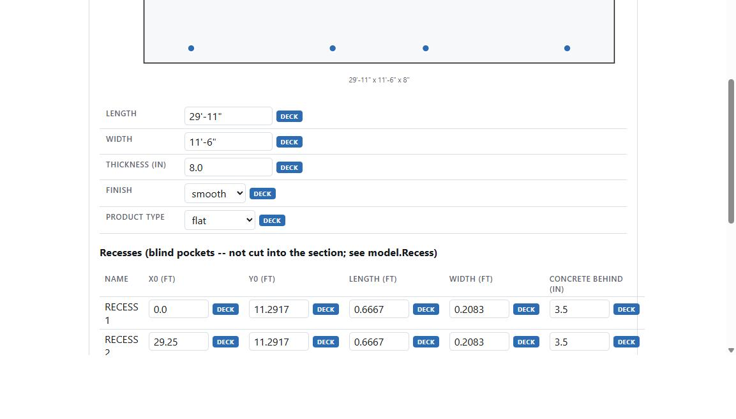
A TOUR OF THE BUTTONS
Panel Analysis (demo) -- geometry pulled straight from the model
The concrete extents plot and every dimension on this page come from the SAME frozen job-file deck as the lift-check report a few slides back
Lifter and strand points plotted directly from measured coordinates -- not redrawn or approximated for the form
Recess geometry -- position, size, concrete behind -- every field chipped DECK, meaning it was actually measured, not assumed
Real output — plan view + recess table, same sanitized deck
Same sanitized deck as slides 18–20. Every field shown here is chipped DECK in the real page.
23
Notes:
This is the same panel and the same underlying deck file as the lift check we walked through earlier -- same length, same width, same thickness, same lifter layout. What's on screen is the plan-view diagram the form draws from the raw measured coordinates in the deck file, plus the dimension fields and the recess table underneath it, every single one chipped DECK to say it came straight from what was measured off the model, not typed in or assumed. This is meant to illustrate that the 'demo' label on this button isn't about the quality of the geometry data -- the geometry is exactly as real and as measured as everything else in the tool. What's still a demo is the analysis that would run on top of it.

Slide 24
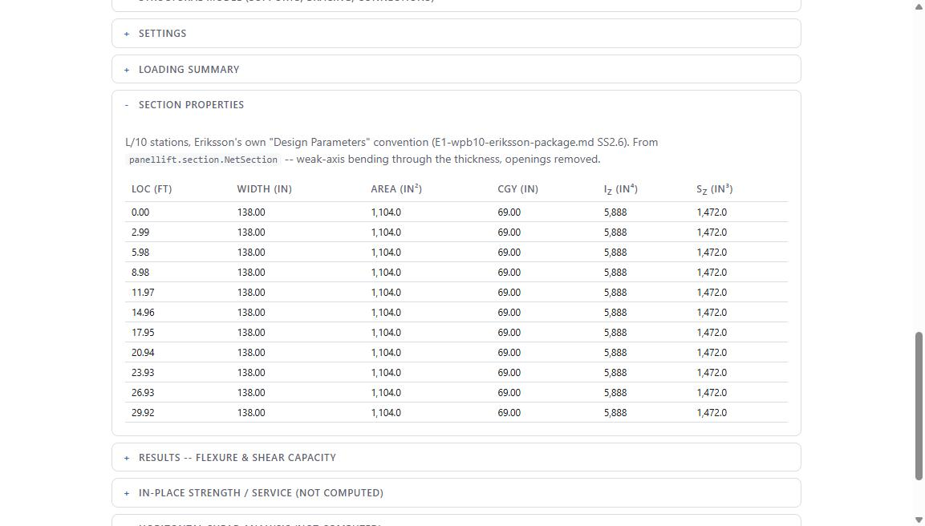
A TOUR OF THE BUTTONS
Panel Analysis (demo) -- results, from panellift's own engine
Section properties at L/10 stations, in Eriksson Wall's own convention -- but computed by panellift.section, the exact same code the lift check uses
Nothing on this page is invented for the demo -- results sections use this tool's real arithmetic or are left as an honest, labeled placeholder
“In-place strength / service (NOT COMPUTED)” -- an unbuilt section says so plainly, rather than rendering a fake zero
Real output — section property table, panellift.section.NetSection
Same sanitized deck. Table generated by panellift.section.NetSection, reused as-is from the checking engine.
24
Notes:
The results sections of this form -- section properties, and capacity where it's shown -- are the one part of the page that isn't an editable input, because they're not sourced from anywhere, they're computed live by panellift's own section and capacity modules, the identical code we already saw producing the lift-check report. Nothing here is invented for the sake of a nicer-looking demo. And you can see the honesty policy extend to what ISN'T built yet -- further down this same page there's a section literally labeled 'in-place strength and service, NOT COMPUTED' -- because wind, seismic, and P-delta analysis are not built into this tool yet, and the page says so in plain language instead of rendering a value that would look like an answer.

Slide 25
A TOUR OF THE BUTTONS
Snapshot & the sandbox
The daily close-out button. The model is 300+ MB on disk and 10+ GB open -- there is never a second copy held in memory at once.
Three phases: index the live document, close Revit (the press itself is the authorization), optionally reopen a detached copy once memory is free
Every request is journalled before the close, and the deferred reopen journals its own outcome -- a day it silently didn't run gets reported in capitals, not silence
The point of the detached copy -- every other tool works on the SANDBOX, never the live model. Reads only, ever, on the real one.
PROJECT.md §1.2, §3.5
25
Notes:
Snapshot is the button most people never think about but that makes everything else safe to use. It takes a timestamped, fully detached copy of the model at end of day, in three careful phases so you never have two full copies of a multi-gigabyte model open in memory at once. But the real point of it is upstream of that: every other button in this tool -- lift checks, ticket QC runs, reinforcing lookups -- is meant to work against that detached sandbox copy, never against the live production model. Nothing in this extension writes document data or geometry to the live model, on purpose, with exactly one narrow exception for temporarily isolating a piece's view during a lift check, which gets written back off when it's done. A wrong report can be disbelieved and rerun. Wrong geometry gets built.

Slide 26
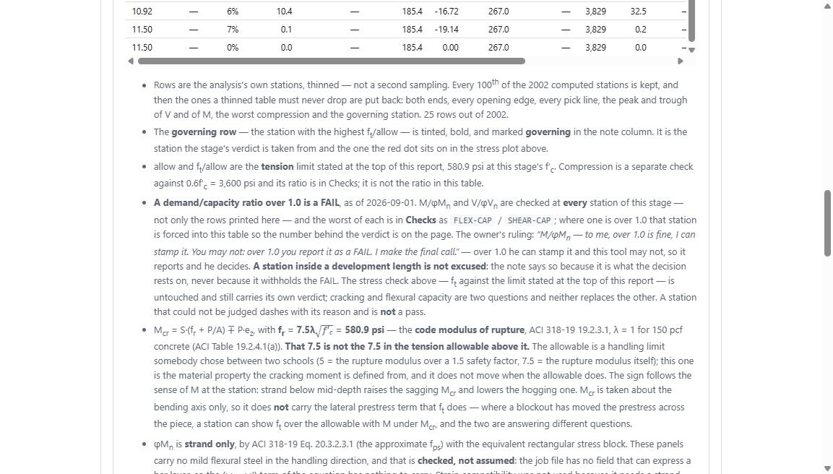
WHAT IT WILL NOT DO
On purpose
No interaction equations unless a ruling says so -- tension and shear are checked separately, deliberately, even where a combined check would look more sophisticated
No guessing at unreadable data -- a value nobody could measure comes back NOT JUDGED, with a named reason, never an assumption
Over 1.0 renders FAIL. Always. The tool will not soften it, discount it, or decide the exceedance doesn't count -- that decision belongs to a stamp, not to code.
From a real report — the ruling, printed for the engineer reading it
Real report text, panellift/src/panellift/capacity.py — owner's ruling, quoted verbatim, 2026-09-01/02.
26
Notes:
I think this is the single most important slide for this audience. The owner's own ruling, printed directly into the report so every engineer reading it sees the reasoning, not just the verdict: 'M over phi M-n -- to me, over 1.0 is fine, I can stamp it. You may not: over 1.0 you report it as a FAIL. I make the final call.' The tool is not allowed to weigh an exceedance, discount it because it's inside a strand's development length, or decide on its own that a 113% ratio is close enough. It reports what it found, with the full reasoning attached, and the decision to accept it stays with the engineer holding the stamp. That's the whole trust model in one sentence, and it's why nothing in this tool ever tries to look more authoritative than the data actually justifies.

Slide 27
TRYING IT
Installing it, and telling us what's broken
Install -- git clone, then python tools/setup_machine.py. It doesn't just report exit codes -- it PROVES itself against a published worked example and checks the computed stress against the published number.
Register the folder with pyRevit's Custom Extension Directories, restart Revit. That's the whole install.
This trial distribution ships with NO knowledge layers -- checks that need one SKIP cleanly and say so. Nothing guesses at a plant standard it was never told.
A good bug report -- what you did, what you expected, what happened instead, your Revit / pyRevit version, and the VERBATIM error text -- rvt.py itself returns {ok, stdout, result, error, traceback} for exactly this reason
This is a young, actively-worked repository -- real fixes have landed within minutes of a report, verified in the commit history, not a marketing claim
INSTALL.md §2; CLAUDE.md §1 (rvt.py exec return shape).
27
Notes:
For anyone who wants to actually try this: it's a git clone, then one setup script. That script doesn't just check that packages installed -- it runs the panellift engine against a real, published worked example from an ASPIRE magazine article and checks the computed stress against the number that article prints, so a successful install is proven, not just reported. Then you point pyRevit at the folder and restart Revit -- that's it. Because this trial ships with no plant-specific knowledge file at all, checks that need one will cleanly SKIP and say exactly why, rather than guessing at a standard nobody told it. When something doesn't work the way you expect, the most useful thing you can hand back is a verbatim error and your environment -- the Revit bridge itself is built to always return the full error and stack trace, precisely because 'it didn't work' with no error text is nearly impossible to act on. I'll be honest -- I don't have a single specific bug-report turnaround time I can quote you and verify in front of you today, but I can tell you this repo is under very active development -- the commit history shows real fixes landing within minutes of each other on the same day, repeatedly.

Slide 28
WHERE IT'S GOING
Roadmap -- modest, on purpose
A three-stage architecture -- pre-processor / engine / post-processor, like scientific analysis software -- so the engine never has to know which plant it's running for
A benchmark corpus -- checks measured against a real, archived ticket set, not just unit tests against synthetic data
Support for a second producer -- the mechanism is designed and one preset exists today. A second one is not written yet, and this document says so rather than guessing at it.
The lifting solver's numerics are the next real gate -- recommendations today are not determined to better than a few inches on some pieces, and that's written down, not hidden
docs/plan-panellift-three-stage.md; PROJECT.md §4.4
28
Notes:
Keeping this slide modest on purpose, because overpromising is exactly the kind of thing this whole tool is built to refuse to do. The architecture is moving toward a pre-processor / engine / post-processor split, the way real scientific analysis software is structured, specifically so the solving engine itself never has to know or care which plant's conventions it's running under -- that logic lives entirely in the pre- and post-processing layers. There's a benchmark corpus effort to check results against a real archived ticket set rather than only synthetic test data. Onboarding a second producer is designed for but genuinely not built -- there is exactly one plant-and-panel-type combination in production use today, and the project's own planning documents are explicit that filling in a second one by guessing would repeat a known error pattern. And candidly, the lift-check solver's own numerics are the next real gate -- recommended insert positions today aren't determined to better than a few inches on some pieces, and on some pieces they may not be the best layout available. That's written down in the project's own docs, not something I'm surfacing for the first time here.

Slide 29
Questions
Silence is never a pass. Every number carries its source.
WillTools — an engineer's QC instrument
Notes:
That's the tour. Happy to take questions -- on anything from the engineering assumptions in the capacity checks, to the knowledge-layer mechanism, to trying it out yourselves. And if anyone wants to look at the actual code for anything I showed today, the module names and section numbers are on the slides -- none of this was hidden behind a black box, and that was the whole point of building it this way.

